Slide 1
Analysis of Ripple Trust Set Network Graph
Rahul (Student)
Amandeep Singh(Student)
Dr. Cüneyt Gürcan Akçora (Professor)

Slide 2
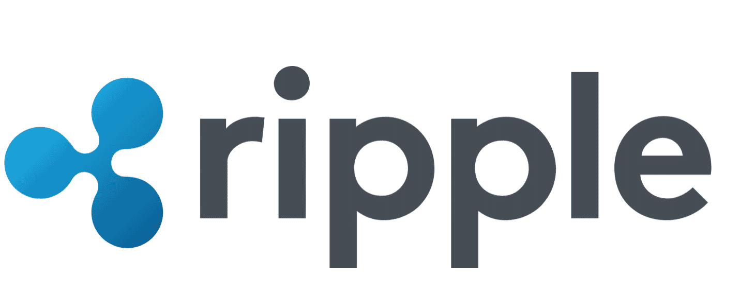
Agenda
Introduction
Ripple Overview
Research Methodology
Graph Analysis
Findings
Conclusion

Slide 3
Ripple in Nutshell
Ripple facilitates fast payments or transfers across countries and currencies
Ripple relies on a common shared ledger
Built with consideration of bank and payment providers
Ripple’s distributed financial technology allows banks to directly transact with other banks to settle transactions in real time

Slide 4
Ripple main agents
Users
Gateways
Trust lines
Validators
Market makers
XRP
IOUs

Slide 5
Ripple main agents
Users: Individual users, Banks, Payment providers, digital asset exchanges and corporates
Trust line: created between account and issuer, where account agrees to hold mentioned currency amount for issuer
Gateways: Businesses that link the XRP Ledger to the rest of the world
Validators: rippled nodes running as a validating server - meaning they are configured to participate in the consensus process for validating transactions

Slide 6
Ripple main agents
Market Makers: Market makers compete for business within the Ripple network, posting orders to buy and sell different currency pairs to facilitate payments
XRP: Ripple’s native cryptocurrency token/digital asset built for payments
IOUs: All currencies other than XRP can be represented in the XRP Ledger as issued currencies and are called as IOUs

Slide 7
Ripple vs Bitcoin
XRP transactions are confirmed in seconds with little cost | Bitcoin transaction confirmations may take many minutes with high transaction costs
It support transactions for fiat currencies apart from its cryptocurrency | It supports only Bitcoin cryptocurrency
It uses distributed consensus mechanism by conducting votes by validators | It uses mining concept to validate the transactions
It have pre-mined crypto coins which are released monthly | Crypto coins are mined by miners
It’s total supply is 100 billion crypto coins | It’s total supply is almost 21 million crypto coins

Slide 8
Who can use Ripple?
Interbank payment network members, operators and liquidity providers
Network members such as banks, financial service businesses
Liquidity providers like central banks, banks and non-bank market makers

Slide 9
Why to use Ripple?
Low commission currency exchange
Fast international transactions
User can basically issue/create his own currency for fast and cheap transaction

Slide 10
What is XRP?
XRP is a token used for representing the transfer of value across the Ripple Network
The main purpose of XRP is to be a mediator for other - both cryptocurrencies and fiat - exchanges
Used for transaction fees

Slide 11





Which banks support ripple?

Slide 12
Trust Set Transaction
Trust Set transactions adds or modifies a trust line linking 2 accounts
Basic trust line:
Agents involved in trust set transaction:
Account: Lawrence
Issuer: Kate
Value: 50
Currency: Euro
30 EUR
45 EUR
Lawrence
50 EUR
Kate
50 EUR
David

Slide 13
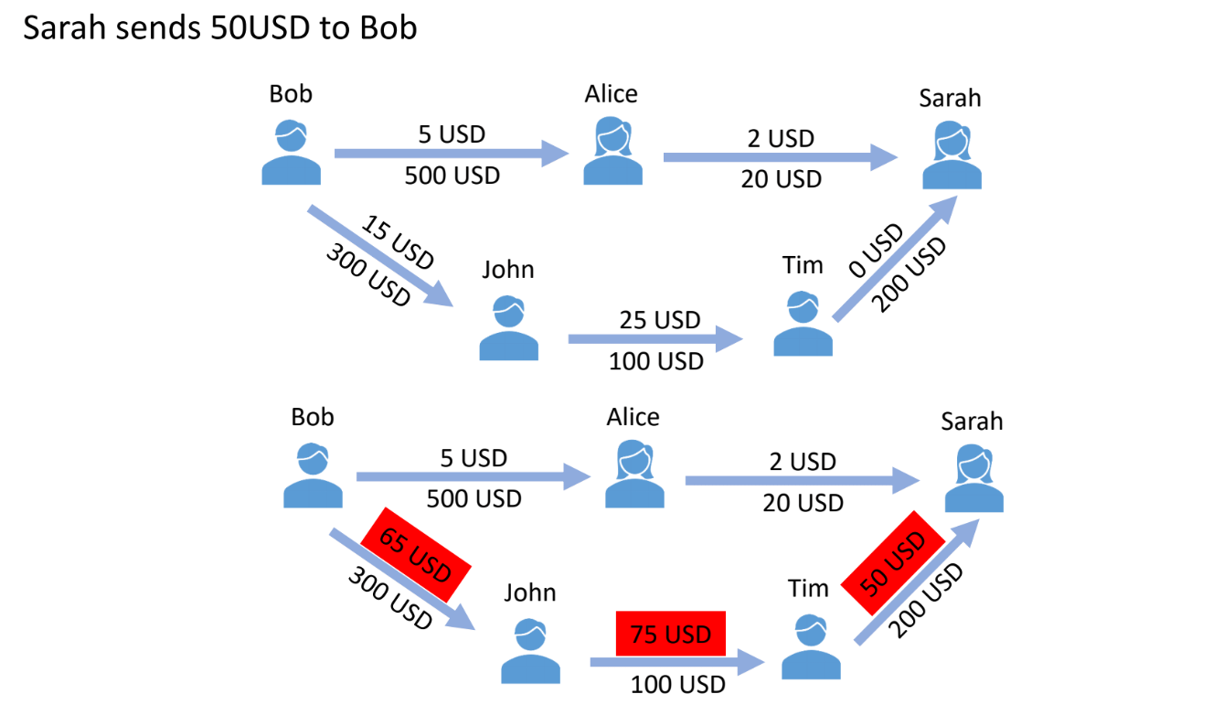
Example
Ripple Network:
Fig 1: (Adapted from class notes)
Sarah sends 50USD to Bob:
Fig 2:(Adapted from class notes)

Slide 14
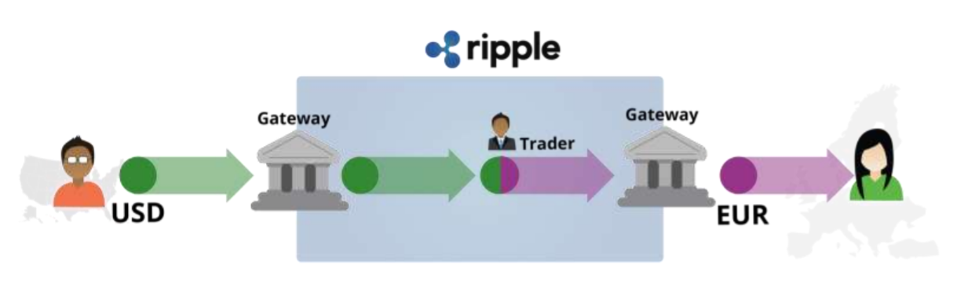
Example using Gateways
David
Kate
Fig 3:(Adapted from Ripple Labs presentation)

Slide 15
Goal of Research
Understand Ripple Transactions
Filter Trust set transactions.
Build Ripple Trust set network graph
Analyze Graph.
Report interesting points.

Slide 16
Data Collection
The Ripple Data API v2 provides access to information about changes in the XRP Ledger, including transaction history and processed analytical data
API used :- https://data.ripple.com/
Method used:- GET /v2/transactions/
Dates included :- January 1 2019 to November 30,2020
Transactions fetched:-1196775 (Trust set transactions)

Slide 17
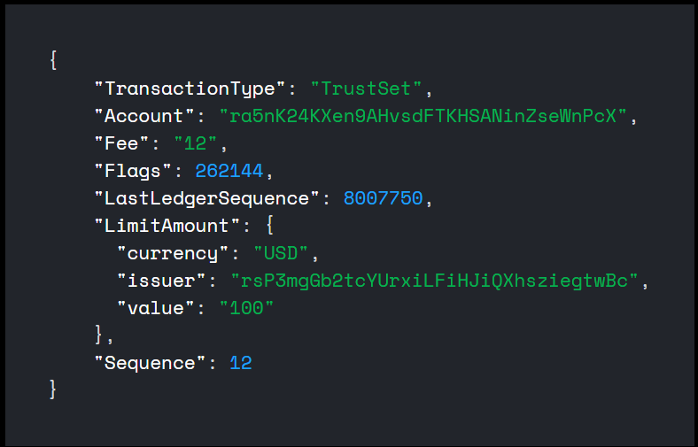
Data Preprocessing
Our Interest lies in
Account
Issuer
Value
Currency
Timestamp
Fig 4:Trustset transaction in JSON format.

Slide 18
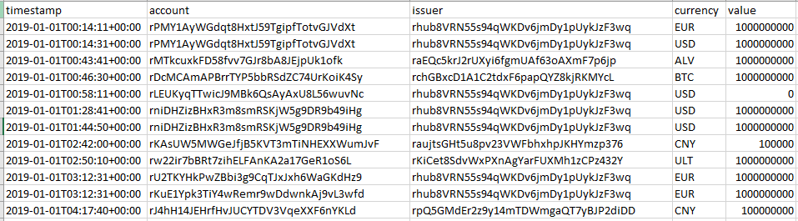
Sample Transactions

Slide 19
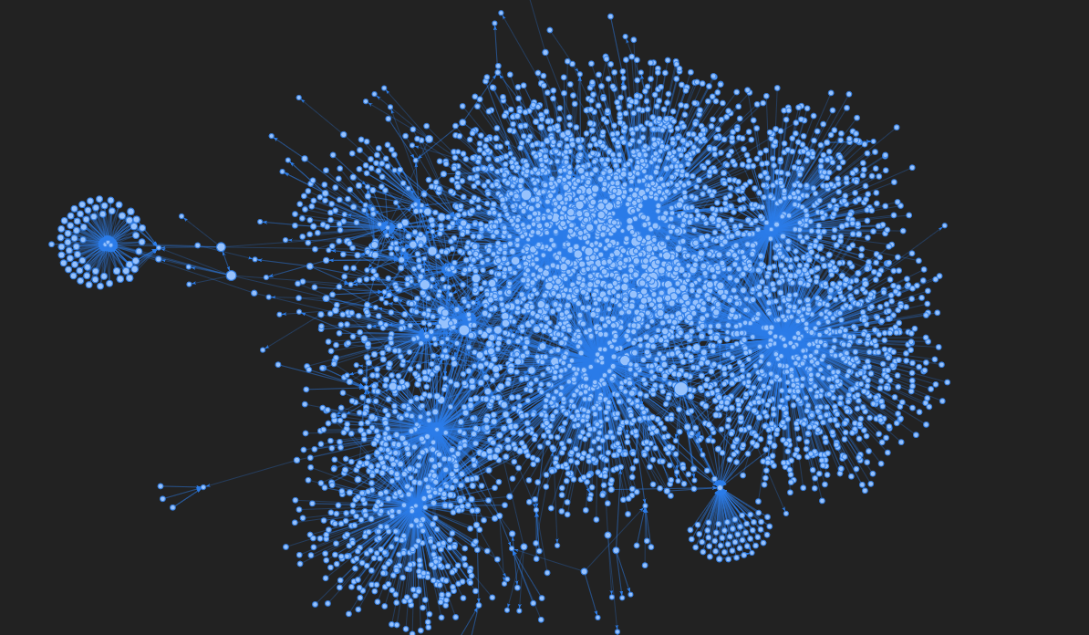
Trust Set Network

Slide 20
Pattern of Transactions from Jan 2019- Nov 2020
Fig 5: Number of Trust set Transactions

Slide 21
Analyzing largest peak in Transactions Graph
Date: 10-January-2020
BTC Transactions breakdown
Currency | Number of Transactions
ALV | 1
BCH | 4
BTC | 25345
DSH | 1
ETC | 1
ETH | 1
EUR | 11
JPY | 1
QAU | 1
REP | 2
USD | 9
Grand Total | 25377
Amount | Number of Transactions
100 | 11353
0 | 8121
300000 | 5691
100000 | 7
1000000000 | 5
110.0803663 | 2

Slide 22
Degree Centrality
Degree is simplest and most common way of finding important nodes.
Fig 6: Top 10 trusted issuers

Slide 23
Top Issuers in Ripple Market
Fig 7: Top issuers identified on ripple network.

Slide 24
What does top issuers in Ripple Market do?
Binance is a cryptocurrency exchange that provides a platform for trading various cryptocurrencies.
Bittrex is a crypto-to-crypto trading exchange. This means you can't buy cryptocurrencies with fiat currencies.
Bitstamp is a bitcoin exchange based in Luxembourg. It allows trading between fiat currency, bitcoin and other cryptocurrency.
GateHub is a Bitcoin, Ripple, Ethereum wallet. Ripple is used by GateHub for trading and moving money across the Ripple network.

Slide 25
Bitstamp analysis(rXTKdHWuppSjkbiKoEv53bfxHAn1MxmTb )
Fig 8: Bitstamp issuer trustset transactions analysis

Slide 26
Gatehub analysis(rhub8VRN55s94qWKDv6jmDy1pUykJzF3wq )
Fig 9: Gatehub issuer trustset transactions analysis

Slide 27
Top 10 currencies
Fig 10: top currencies used on ripple network

Slide 28
Patterns of Transactions of Top 4 nodes
Fig 11: Transaction graph for top 4 nodes

Slide 29
Patterns of Trusts between nodes
Account - rBHWm3dzrSm8uuyTrTTj5T4UgYXqwUwRY
Issuer- rXTKdHWuppSjkbiKoEv53bfxHAn1MxmTb (Gatehub)
r9xYSiMrPinU9k5sAK9YgZhKiwgHP7Cvd3 rXTKdHWuppSjkbiKoEv53bfxHAn1MxmTb
Fig 12: Patterns of trustline between nodes

Slide 30
Average degree of the Graph
Average degree is the average number of connections of each node in your network.
Average degree is 3.1715

Slide 31
Density of the Graph
The ratio of actual edges in the network to all possible edges in the network.
Network density gives you a quick sense of how closely knit your network is
Density of Graph is 7.834234189720022e-05

Slide 32
Diameter of the Graph
Diameter is the longest of all shortest paths.
After calculating all shortest paths between every possible pair of nodes in the network, diameter is the length of the path between the two nodes that are furthest apart.
Diameter is 12

Slide 33
Clustering Coefficient
Clustering coefficient is a measure of the degree to which nodes in a graph tend to cluster together.
When these connections are dense, the clustering coefficient is high.
Average clustering coefficient is 0.14807293789007314

Slide 34
Conclusions
Reviewed Ripple network and its agents
Understood Trustset transactions methodology
Analyzed Trustset transactions in network and trust lines graph
Able to map most important node to real world entities.

Slide 35
Any Questions

